Slide 1
Employee Data Analysis using Excel
STUDENT NAME: SATHYA BAMA R
REGISTER NO: 122200933 , 0AD4077B07BFFEA9EF045FFF6BA03E15
DEPARTMENT: BACHELOR OF COMMERCE (CORPORATE SECRETARYSHIP)
COLLEGE: K.C.S.KASI NADAR COLLEGE OF ARTS AND SCIENCE

Slide 2

PROJECT TITLE
Employee Rating Based on Job Type Data Analysis using Excel

Slide 3



AGENDA
Problem Statement
Project Overview
End Users
Our Solution and Proposition
Dataset Description
Modelling Approach
Results and Discussion
Conclusion
3/21/2024 Annual Review

Slide 4

PROBLEM STATEMENT
The company needs a way to visualize and analyze employee satisfaction ratings based on job type to identify areas for improvement and enhance overall employee experience.

Slide 5

PROJECT OVERVIEW
Project Overview:This project appears to be analyzing overall ratings based on job types (Contractual, Full Time, Intern, Part Time).
Key Insights:
Full-Time employees have the highest overall ratings:This is evident from the tallest bars in the chart, indicating a larger number of high ratings for this job type.
Contractual and Part-Time employees have lower ratings:Their bars are considerably shorter, suggesting fewer high ratings compared to Full-Time employees.
Intern ratings are the lowest:This job type has the shortest bars, indicating the least number of high ratings.

Slide 6


WHO ARE THE END USERS?
It presents data on overall ratings based on job type, suggesting the end users are likely HR professionals, managers, or other stakeholders interested in analyzing employee satisfaction or performance across different job categories.

Slide 7

OUR SOLUTION AND ITS VALUE PROPOSITION
Data Cleaning: Data cleaning is a process required to remove incomplete records, and modifying data to rectify inaccurate records.
Filter: It take my dataset and show only the data that meet my criteria specify.
Conditional Formatting: It is used to specify important values stand out in employee performance score in a data set.
Slicer: I used slicer to filter my data.
Pivot Table: I used "pivot table to summarize my huge data. Pivot Chart: I used using area graph. "pivot chart" to visually summarises my data.

Slide 8

Dataset Description
Place: The location of the job, likely city and state.
Job Type: The type of employment, such as Full Time, Part Time, etc.
Department: The specific department within the company where the job is located.
Overall Rating: A numerical rating indicating the overall satisfaction with the job.
Work-Life Balance: A rating for the work-life balance offered by the job.
Skill Development: A rating for the opportunities for skill development and growth.
Salary & Benefits: A rating for the salary and benefits package offered.

Slide 9

THE "WOW" IN OUR SOLUTION
Data visualization
I used data visualization to represent my graph
I used animation for movement of words.
Transition
Animations
I used transition for movement of slides.
3/21/2024 Annual Review
9

Slide 10
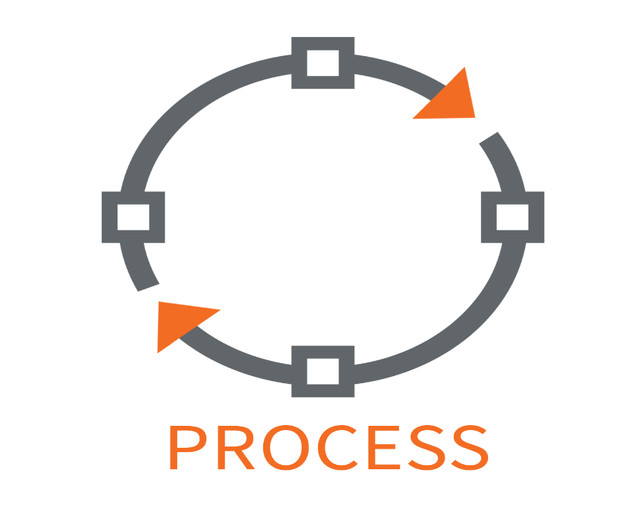
MODELLING
Data set was downloaded from Kaggle website
Extract it from zip format.
Data Cleaning: Data cleaning is a process required to remove incomplete records, and modifying data to rectify inaccurate records.
Filter: It take my dataset and show only the data that meet my criteria specify.
Conditional Formatting: It is used to specify important values stand out in employee performance score in a data set
Slicer: I used slicer to filter my data
Pivot Table: I used "pivot table to summarize my huge data
Pivot Chart: I used graph. "pivot chart" to visually summarises my data
10

Slide 11
RESULTS
JOB | 0VERALL RATING
Row Labels | 1 | 2 | 3 | 4 | 5 | Grand Total
Contractual |  |  | 3 |  |  | 3
Full Time | 10 | 20 | 60 | 128 | 70 | 288
Intern |  |  |  |  | 5 | 5
Part Time | 1 |  |  |  |  | 1
Grand Total | 11 | 20 | 63 | 128 | 75 | 297
11

Slide 12

conclusion
This chart illustrates the overall ratings for different job types. Full-time positions received the highest number of ratings across all categories, particularly excelling in the 4 and 5 rating levels.
Part-time and intern positions received significantly fewer ratings, with the majority falling into the lower rating categories.
Contractual positions also had a limited number of ratings, mostly concentrated in the middle range.
In conclusion, full-time jobs appear to be the most favored among respondents, while part-time and intern positions are less popular and potentially less satisfying.

Slide 13
THANK YOU

